Slide 1
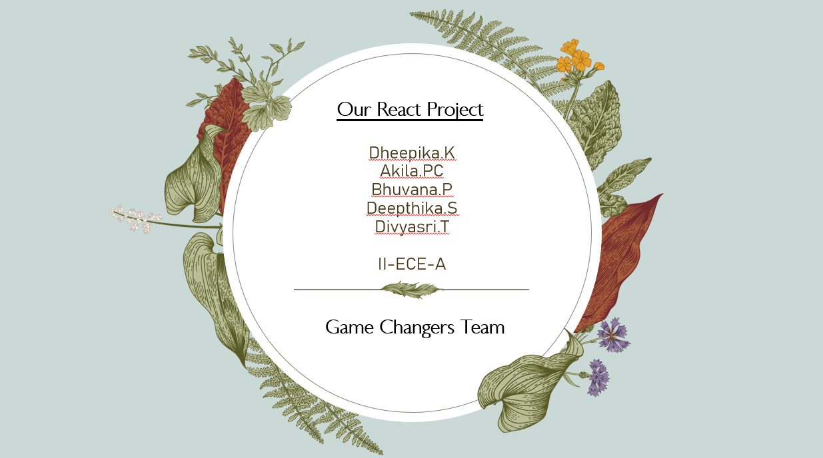

Slide 2
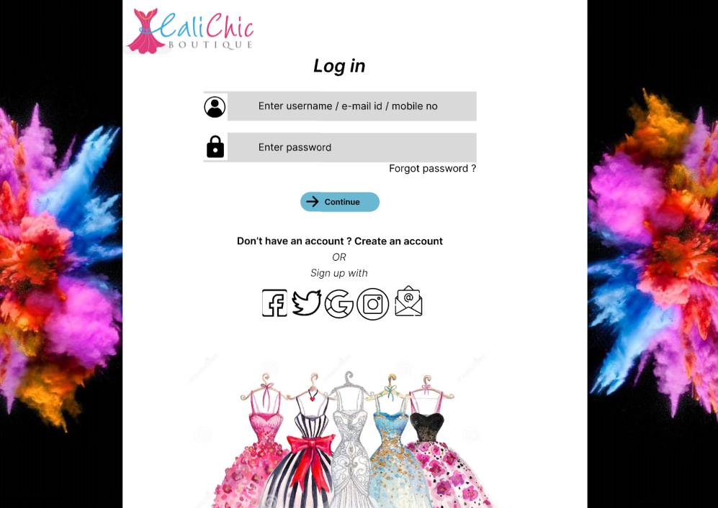

Slide 3
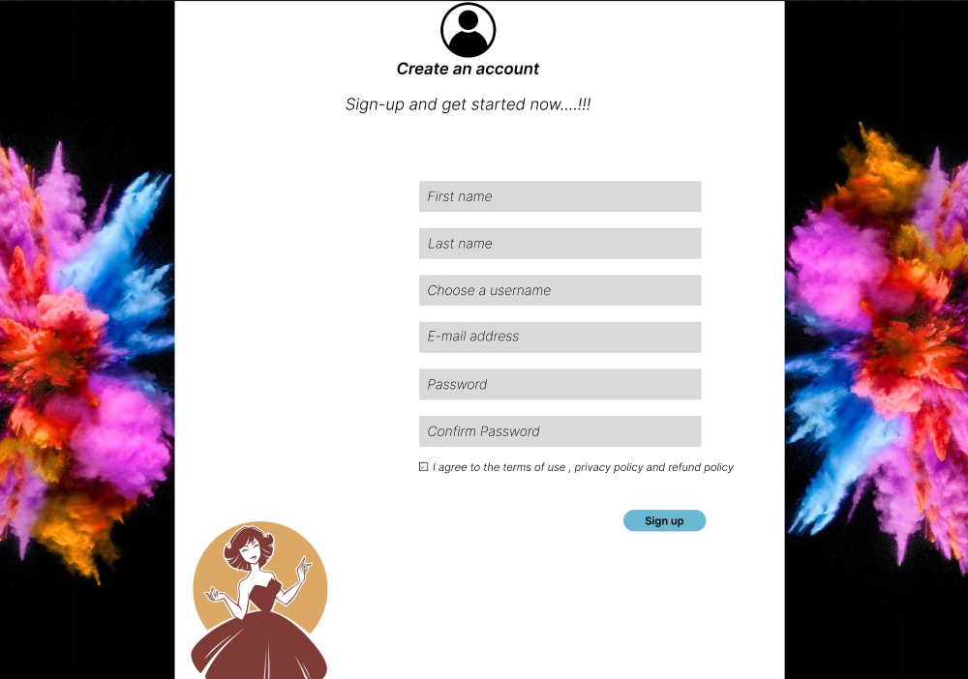

Slide 4
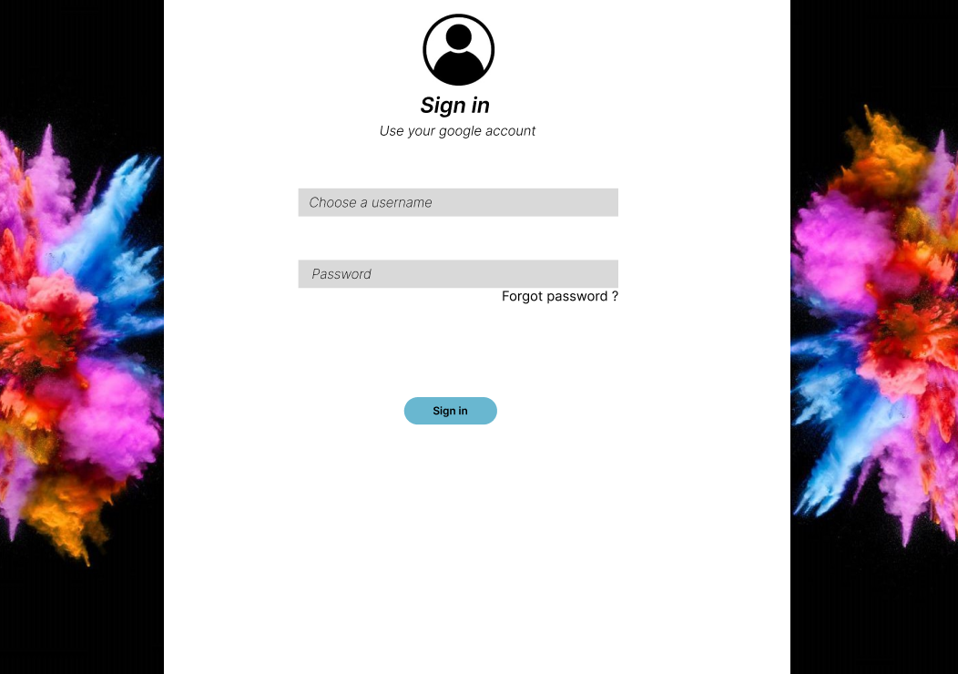

Slide 5
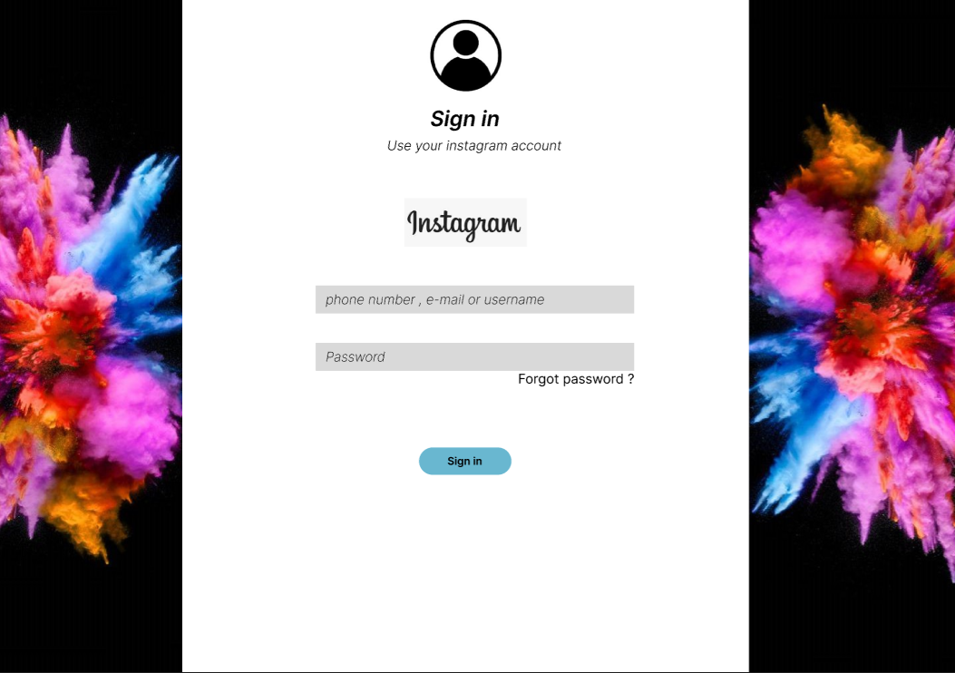

Slide 6
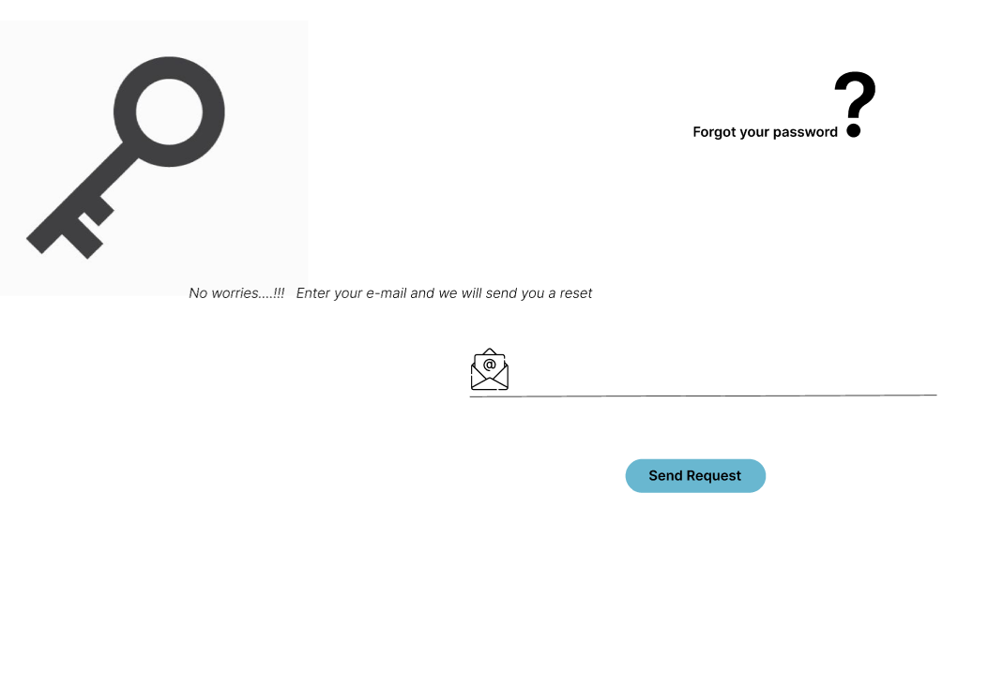

Slide 7
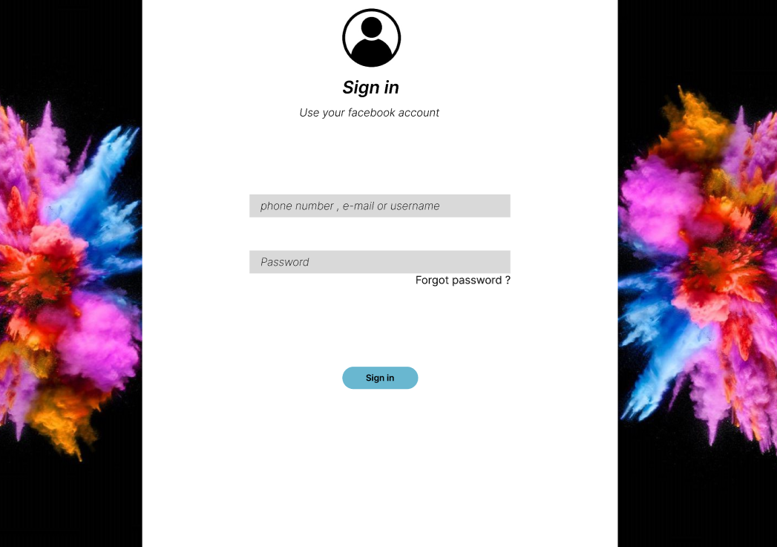

Slide 8
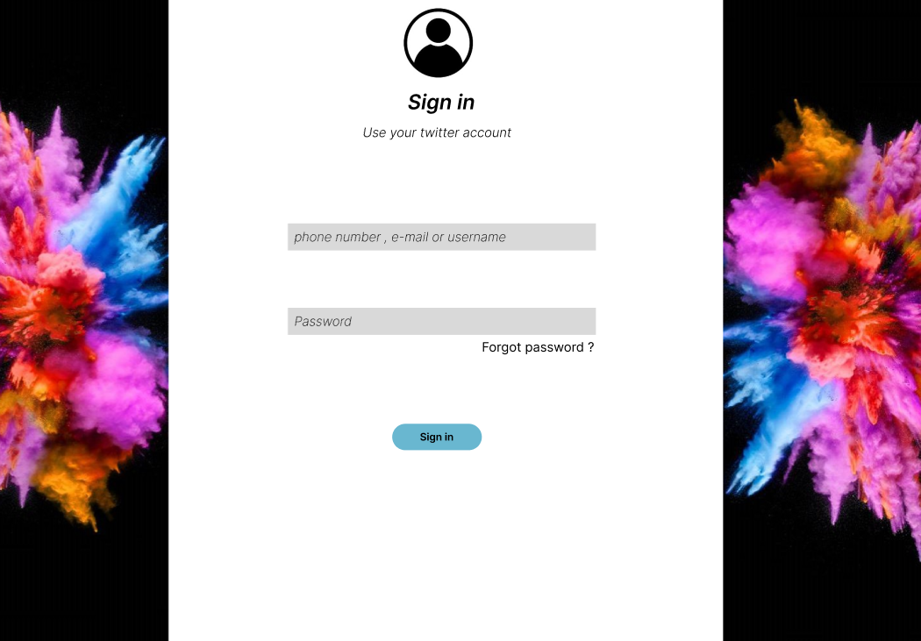

Slide 9
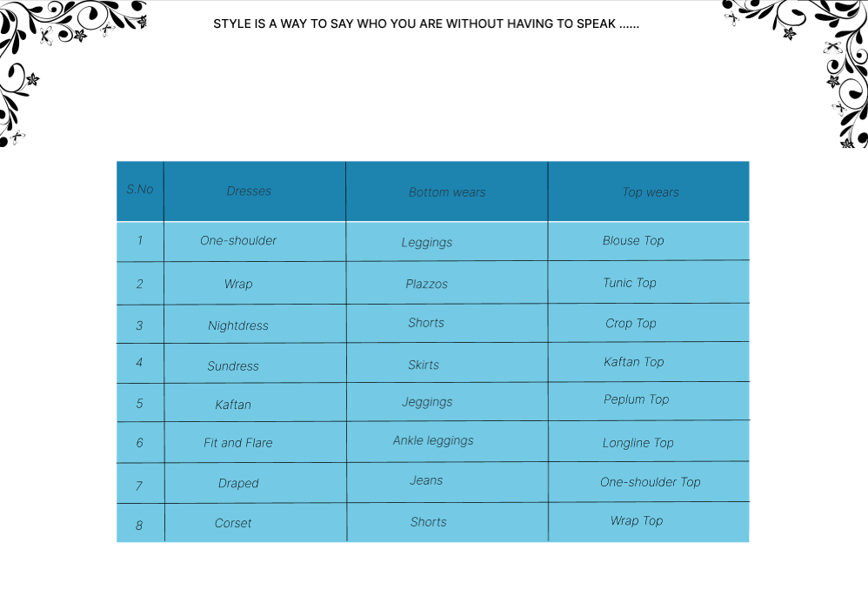

Slide 10
https://www.figma.com/file/L9XGFqGPAAKBc2C0FOXW9T/Dress-Shopping?node-id=0%3A1
FIGMA LINK
GITHUB LINK
https://github.com/dheepika-13/Our-React-Project.git

Slide 11


